Slide 1
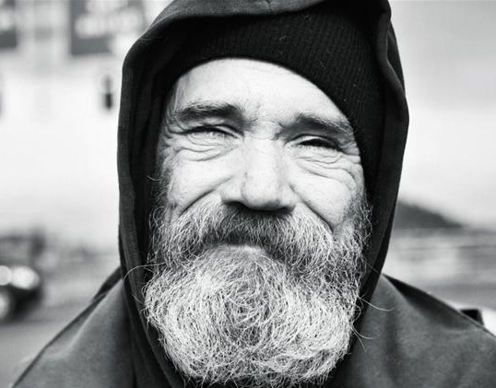
101DONATIONS
Power to change your community, in the palm of your hand

Slide 2
DISCOVER CHARITIES
1
2
CONNECT
3
GIVE BACK

Slide 3
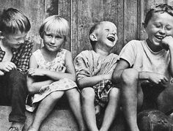
101DONATIONS
Power to change your community, in the palm of your hand

Slide 4
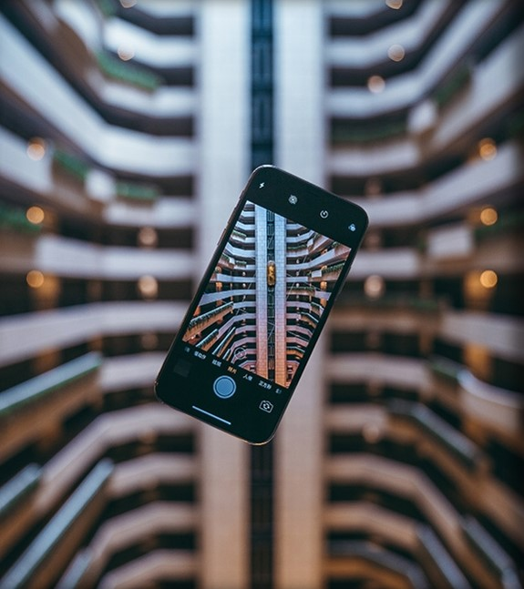

Large Picture Slide
THE FIRST
OF ITS KIND

Slide 5
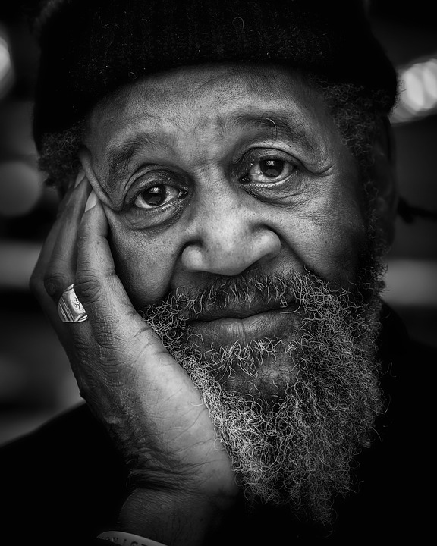
101DONATIONS
Power to change your community, in the palm of your hand

Slide 6



charitable giving
PROMOTE
local charities
sustainable consumerism

Slide 7
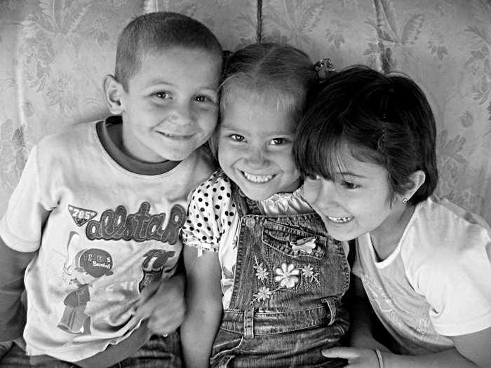
101DONATIONS
Power to change your community, in the palm of your hand

Slide 8

In 3 easy steps
you’re on your way
with 101 Donations

Slide 9
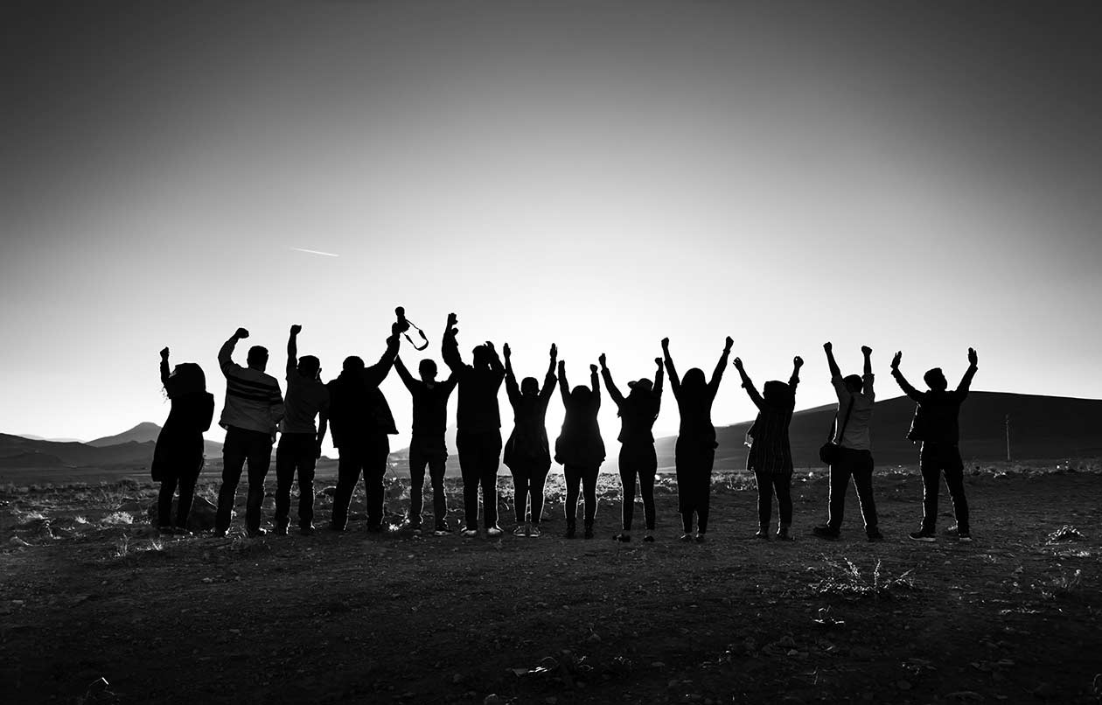
101DONATIONS
Power to change your community, in the palm of your hand

Slide 10



Track your impact
Get to know your donors
Extend your horizons

Slide 11
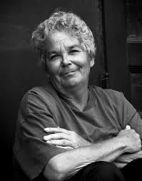
101DONATIONS
Power to change your community, in the palm of your hand

Slide 12

We share your profile with charities
But YOU control what we know

